Slide 1
Project Presentation of Exploratory Project (CS-302)
On
PEEPPOST
Parwinder Singh (2110996028),
Samyak Jain(2110992476),
Raghav Purohit(2110992352),
Supervised By
Preeti Saini
Department of Computer Science and Engineering,
Chitkara University, Punjab

Slide 2
Introduction
PeepPost is an innovative social media platform designed to facilitate seamless, real-time communication and content sharing among users.
Inspired by the simplicity and immediacy of Twitter, PeepPost aims to provide a user-friendly and engaging experience while incorporating unique features to enhance social interaction.
PeepPost allows users to post "Peeps" – short messages up to 280 characters – with ease. Users can enjoy personalized timelines, real-time notifications, advanced privacy settings, and customizable user profiles.
2

Slide 3
Why Choose PeepPost ?
Innovative Social Media Experience:
PeepPost is designed to revolutionize real-time communication, combining the best aspects of existing platforms with unique, innovative features. Our focus on user experience, privacy, and engagement sets us apart from competitors.
Robust Technology Stack:
PeepPost leverages a cutting-edge technology stack, including React for the frontend, Node.js and Express.js for the backend, and MongoDB and Firebase for data management. Our use of modern, scalable technologies ensures a reliable and high-performance platform.
User-Centric Design:
We prioritize the needs and preferences of our users, offering customizable profiles, personalized timelines, and a wide range of interactive features. PeepPost is built to provide a seamless and enjoyable experience for all users.
Engagement and Community Building:
PeepPost is designed to foster community engagement through features like Peeps, likes, comments, shares, hashtags, and trends. Our platform encourages meaningful interactions and connections among users.

Slide 4
Key Features
User Profiles: PeepPost allows users to create customizable profiles where they can add profile pictures, write bios, and include personal information. These profiles help users to express their identity and connect with others who share similar interests.
Peeps: Users can post "Peeps," which are short messages of up to 280 characters. This feature enables quick, concise communication, making it easy to share thoughts, updates, and engage with followers.
Timeline: The personalized content feed, or timeline, shows users the latest Peeps from the people they follow. The timeline is tailored to each user’s interests and interactions, ensuring they see the most relevant and engaging content.
Interactions: PeepPost supports various forms of interaction, including likes, comments, and shares. These interactions help to foster community engagement, allowing users to express appreciation, provide feedback, and amplify the reach of their favorite Peeps.
Direct Messaging: PeepPost includes a secure direct messaging feature for private conversations between users. This allows for more personal communication and the sharing of content privately.

Slide 5
Technology Stack
Frontend:
React: Utilized for building dynamic, responsive, and efficient user interfaces. React’s component-based architecture allows for the creation of reusable UI components, improving development speed and maintainability.
HTML5 and CSS3: Standards for structuring and styling web pages. HTML5 provides the semantic structure, while CSS3 is used for layout, design, and visual effects.
JavaScript (ES6+): The programming language of the web, used for adding interactivity to the user interface. Modern JavaScript (ES6+) introduces features like arrow functions, classes, and modules, enhancing code readability and efficiency.
Backend:
Node.js: A powerful JavaScript runtime built on Chrome’s V8 engine, enabling server-side execution of JavaScript. Node.js allows for scalable network applications and efficient handling of concurrent requests.
Express.js: A fast, unopinionated, and minimalist web framework for Node.js. It provides a robust set of features to develop web and mobile applications, facilitating the creation of APIs and handling HTTP requests.
Database:
MongoDB: A NoSQL database known for its high performance, flexibility, and scalability. MongoDB stores data in JSON-like documents, making it easy to work with and integrate into modern applications.

Slide 6
Conclusion
PeepPost is more than just a social media platform; it is a dynamic space designed to revolutionize real-time communication and content sharing.
Innovative Features: From customizable user profiles and personalized timelines to secure direct messaging and advanced privacy settings, PeepPost offers a robust set of features that enhance user engagement and interaction.
Cutting-Edge Technology: Leveraging modern technologies such as React, Node.js, MongoDB, and Kubernetes, we have built a scalable, reliable, and high-performance platform.
User-Centric Design: Our focus on usability and user experience ensures that PeepPost is intuitive and enjoyable for all users, fostering a vibrant and active community.
Security and Privacy: With stringent security measures and comprehensive privacy settings, PeepPost prioritizes the protection of user data and provides a safe online environment.

Slide 7
Future Scope.
PeepPost is poised to make a significant impact in the social media landscape by offering a unique and engaging experience. As we continue to evolve, we are committed to:
Continuous Improvement: Regularly updating and enhancing the platform based on user feedback and technological advancements.
Community Building: Fostering a strong, supportive, and inclusive community where users can share ideas, connect with others, and stay informed.
Innovation: Exploring new features and technologies to keep PeepPost at the forefront of social media innovation.

Slide 8
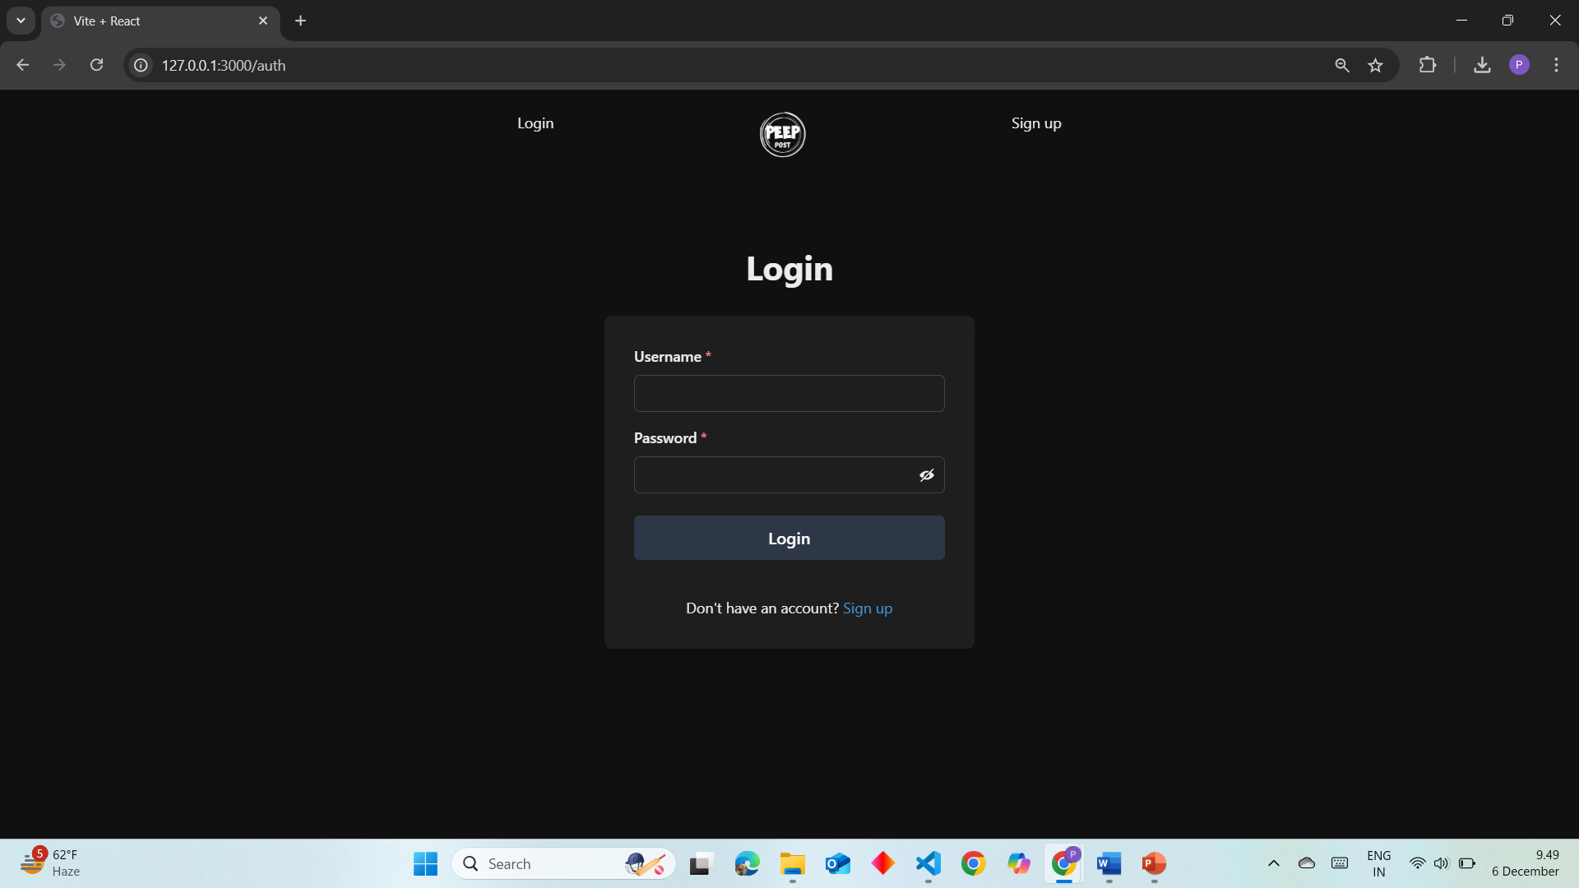
Work done till now…
Login Form: The screenshot displays a user registration form. Users can input their details, including username, and password. The form likely includes validation checks to ensure data accuracy.

Slide 9
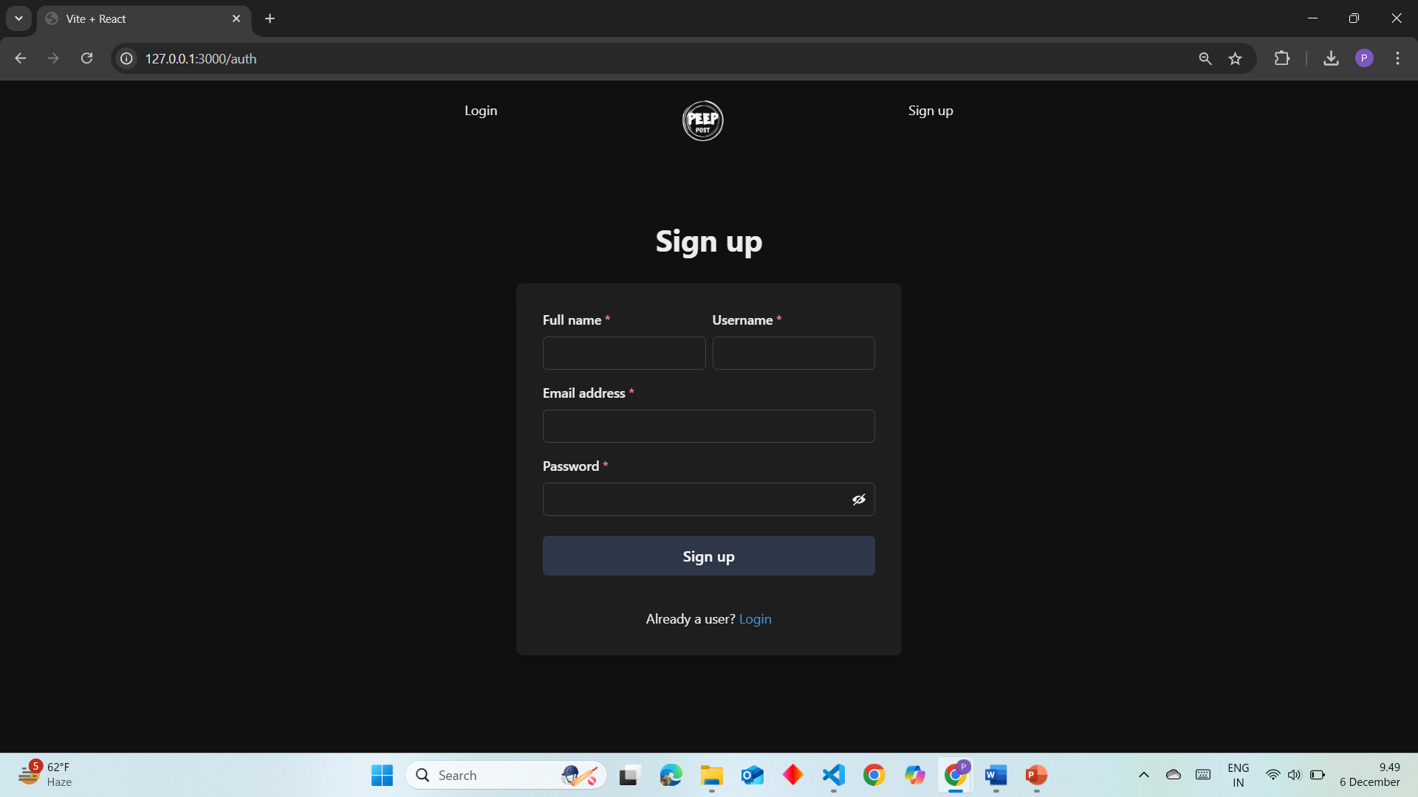
Sign-Up Form: To create an account, simply provide your full name, username, email address, and password. Click the “Sign Up” button to complete the process.

Slide 10
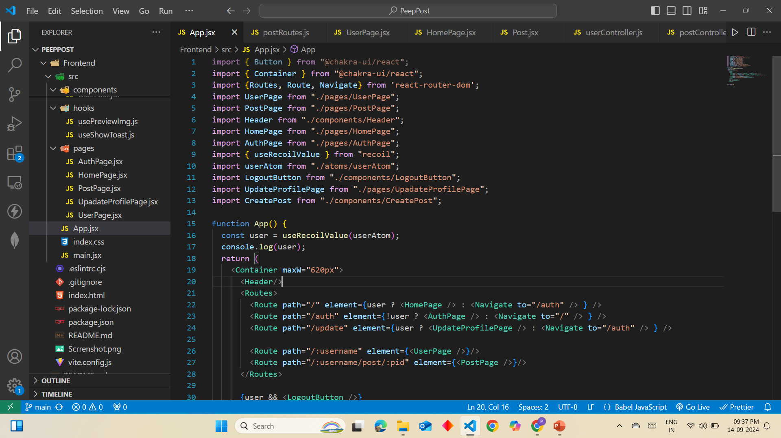

Slide 11
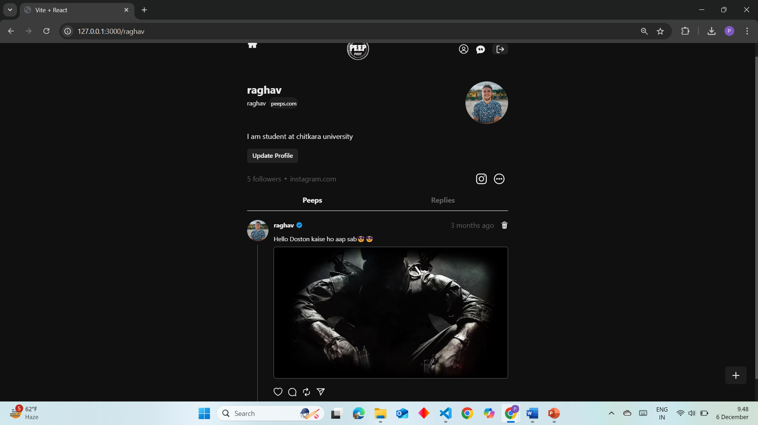


Slide 12
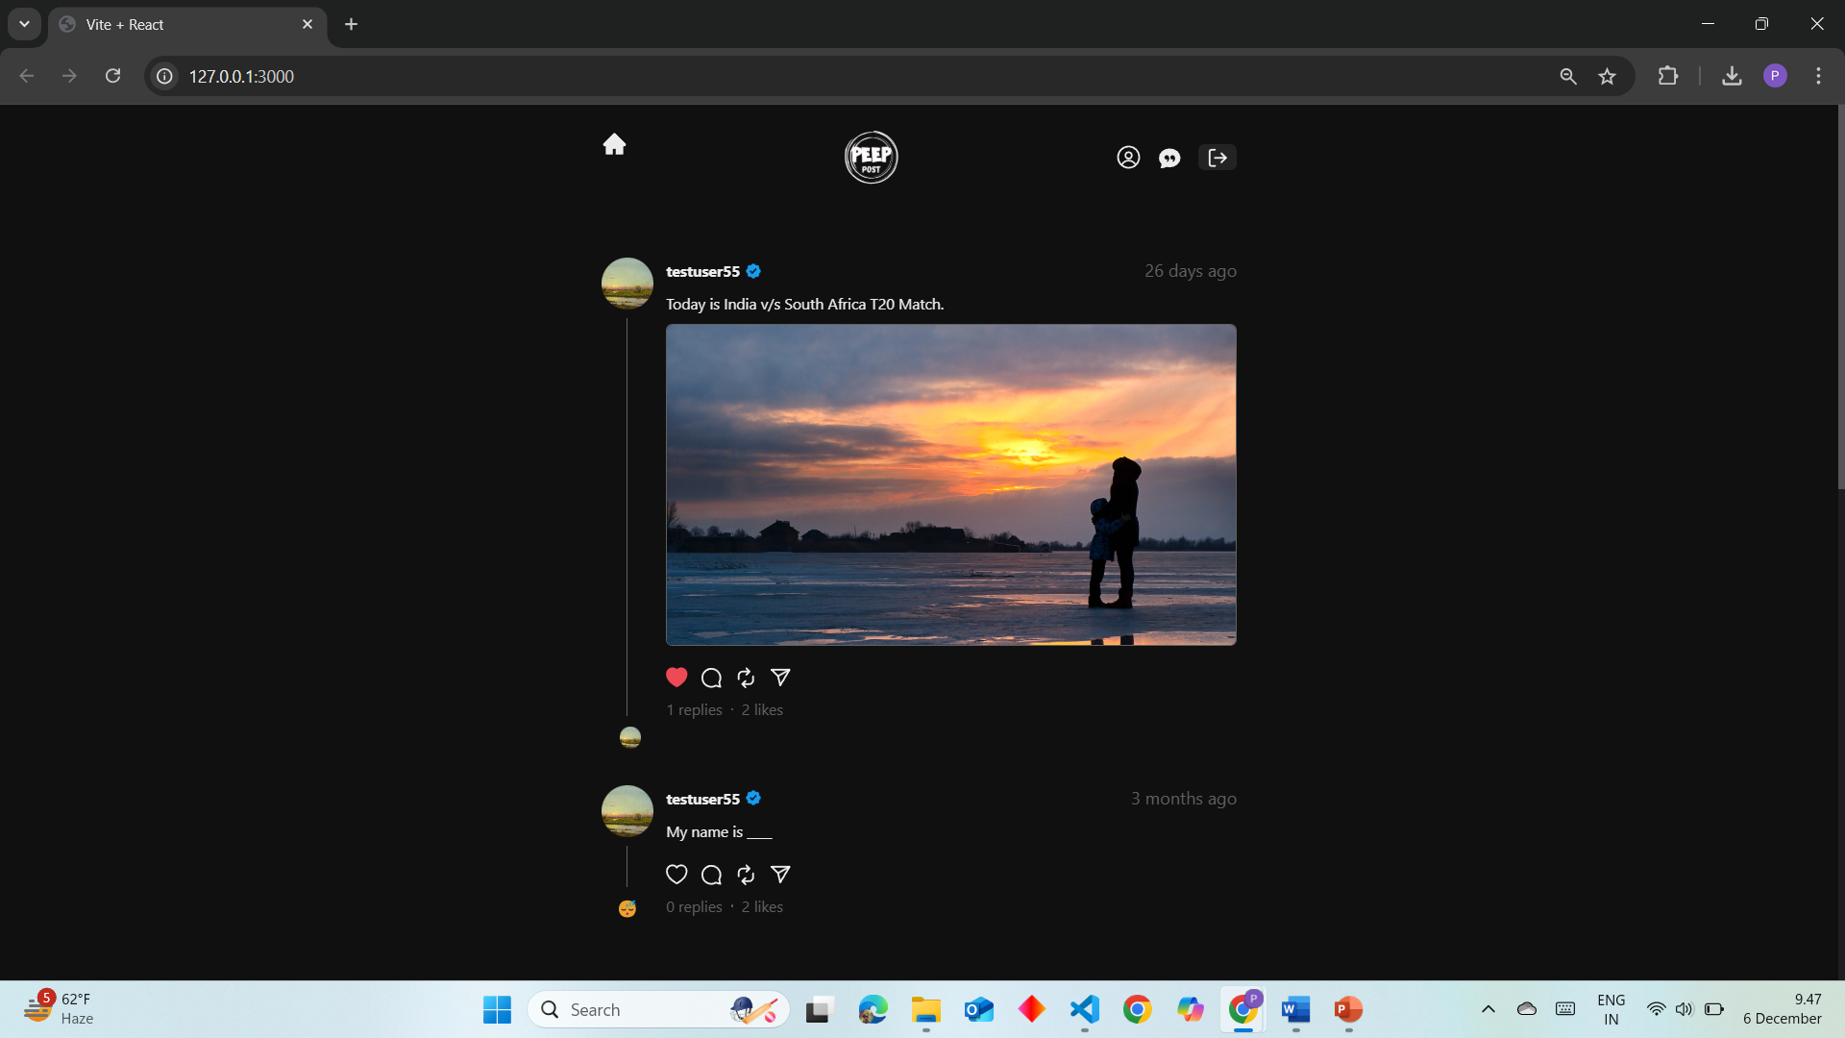
Home Page : It shows all the peeps that the user is following

Slide 13
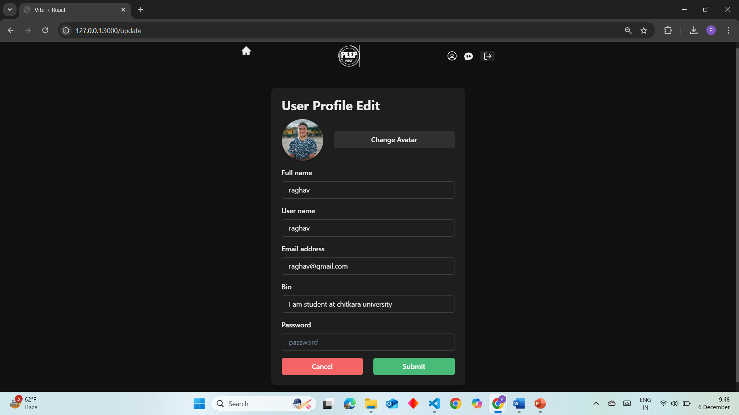
Update Profile Page

Slide 14
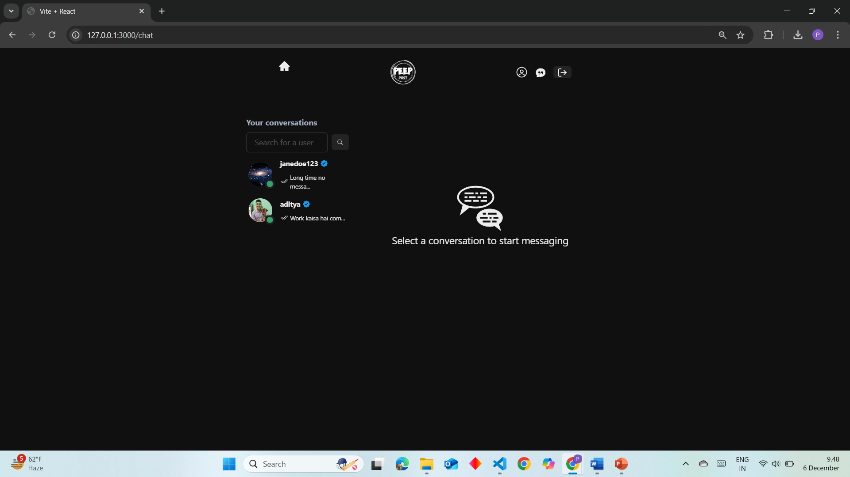
Chat Page

Slide 15
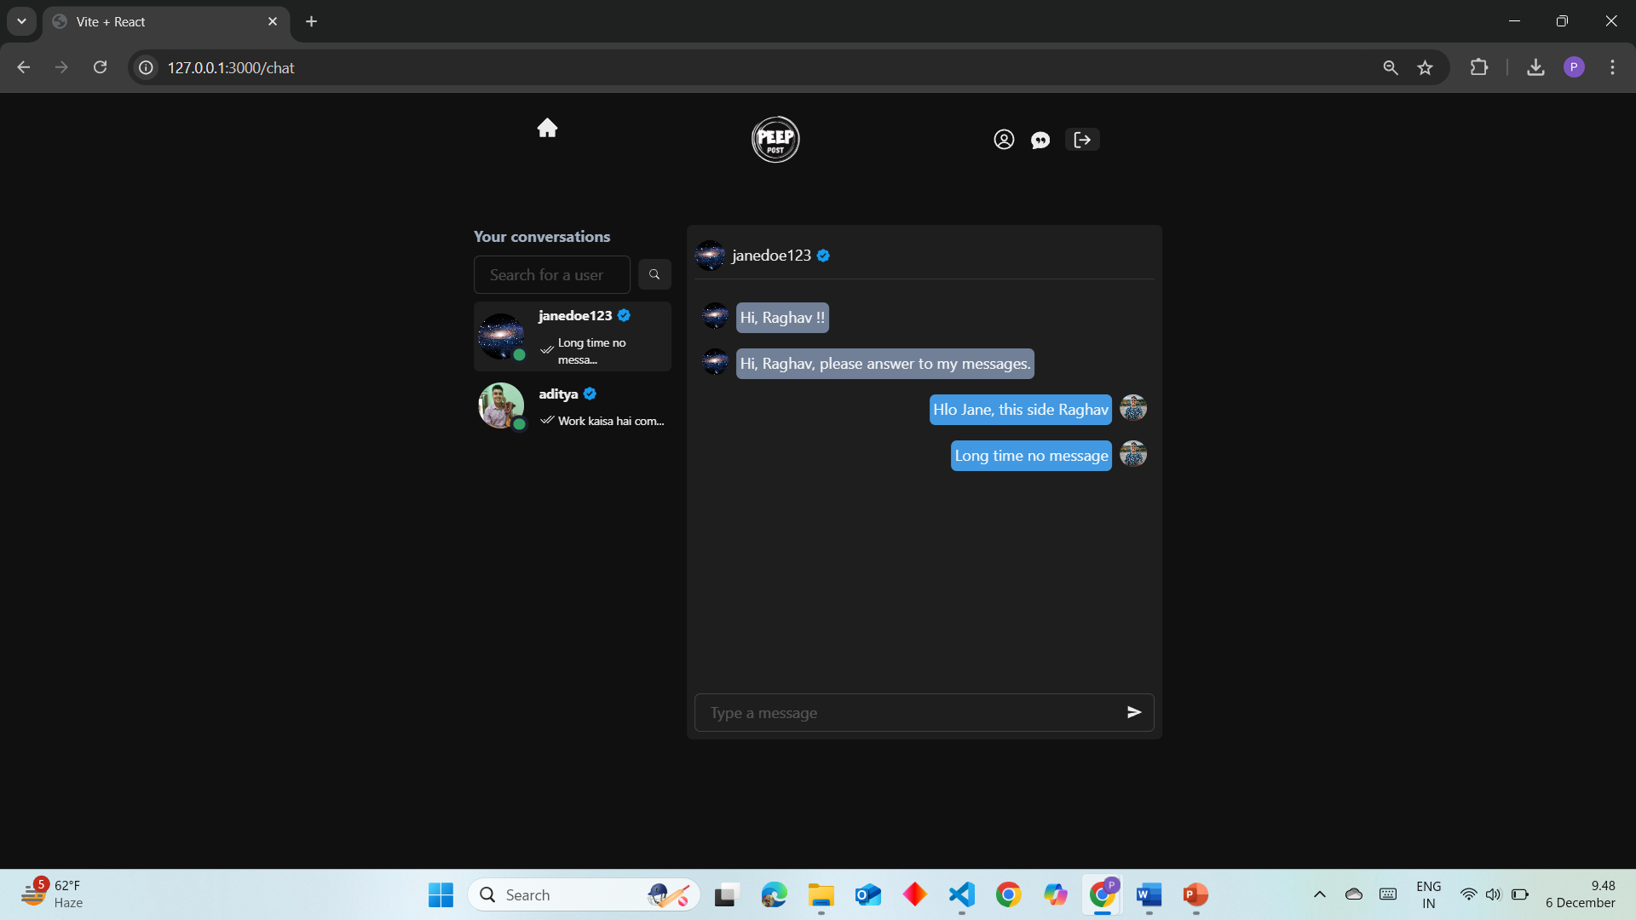

Slide 16
Thank You
16

